Slide 1
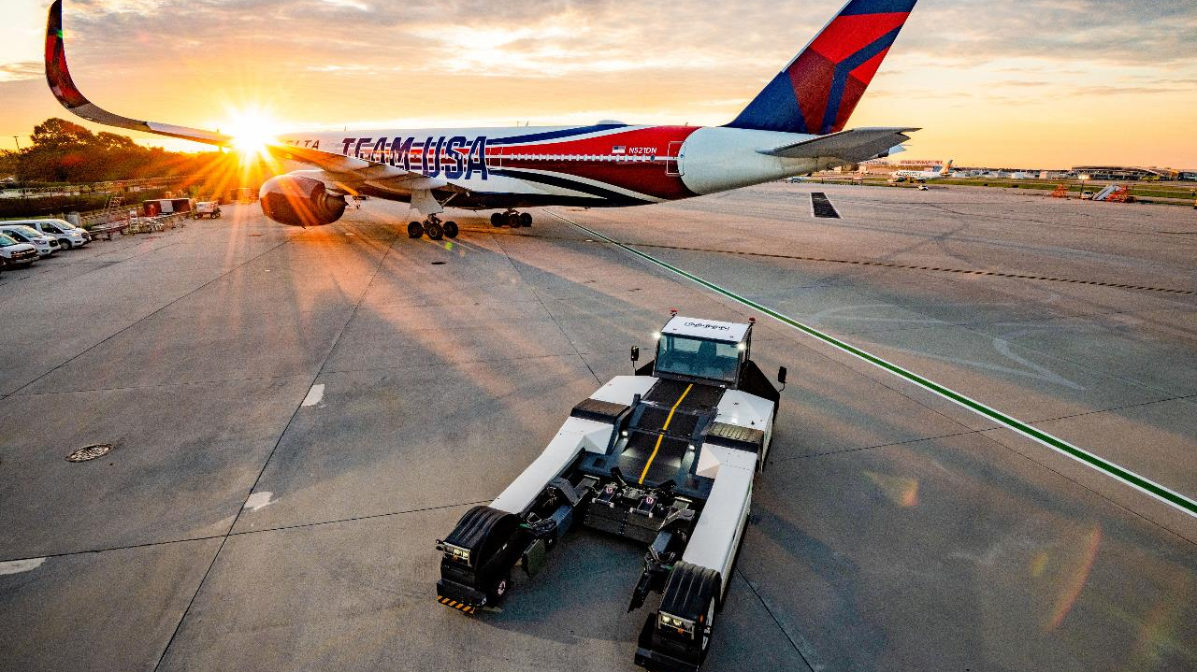
GSE Monthly Performance Review
May 2026

Slide 2
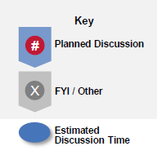
Planned Discussion
GSE Monthly Performance Summary
1
5 min
2
3
4
5
6
7
8
9
10

Slide 3
System Scorecard
Monthly Performance System
Speaker: Blake Green

Slide 4
System Scorecard
Monthly Performance System
Speaker: Blake Green

Slide 5
GIR
Safety
Speaker: M. Gordy, R. Shacklett, C. Scott
System GIR
May'26
Actual: | 4.00
Plan:
YoY Actuals
Yo1Y: | 6.06
Yo2Y: | 3.04
Injury Breakdown
Year | Total | Rec | NonRec | DART
2025 | 44 | 22 | 22 | 16
587 | 23 | 12 | 11 | 9
613 | 21 | 10 | 11 | 7
2026 | 15 | 7 | 8 | 2
587 | 11 | 5 | 6 | 2
613 | 4 | 2 | 2 | 1
Total | 59 | 29 | 30 | 18
Recordable | Jan | Feb | Mar | Apr | May | Jun | Jul | Aug | Sep | Oct | Nov | Dec | YTD | YTD Goal Var
System GIR | 0.00 | 4.69 | 0.00 | 0.00 | 4.00 |  |  |  |  |  |  |  | 1.72
Injury Count | 0 | 0 | 0 | 0 | 0 |  |  |  |  |  |  |  | 0
Metric | Month to Date |  |  | Year to Date |  |  | Score
 | Actual | Goal | +/- vs Goal | Actual | Goal | +/- vs Goal | MTD | YTD
GIR | 4.00 |  |  | 1.72 |  |  | 2.74 | 5.00
Leading Issues
Action Plan
ATL (M) – Wrist injury
ATL (S) - EE bumped his head working on a catwalk - a week later his neck hurt and he remembered he bumped his head - still out
ATL (M) - Communicated injuries to D587ATL, conducted IPGs and continually brief the importance of safety in all shift briefings.
ATL (S) - Talk with team about situational awareness and importance of PPE

Slide 6

EA Compliance / ASAP Reporting
Safety
Speaker: R. Shacklett, K. Kotula
Leading Issues

Slide 7
Leadership Engagement/Psychological Safety/Accountability
People
Speaker: Blake Green
PEOPLE | MTD |  | YTD |  | Score
 | Actual | B/(W) Goal | Actual | B/(W) Goal | MTD | YTD
LEADERSHIP ENGAGEMENT |  | - |  |  | 5.00 | 5.00
I trust my leader | - | - | 83 | 1 | 5.00 | 5.00
My direct leader provides me with feedback that helps me improve my performance | - | - | 84 | 2 | 5.00 | 5.00
PSYCHOLOGICAL SAFETY |  | - |  |  | 5.00 | 5.00
I feel free to speak my mind without fear of negative consequences | - | - | 78 | 9 | 5.00 | 5.00
I feel free to challenge the way things are done here | - | - | 80 | 10 | 5.00 | 5.00
ACCOUNTABILITY |  | - |  |  | 5.00 | 4.88
Where I work, employees are held accountable for their work | - | - | 67 | (1) | 5.00 | 4.88
Leading Issues
Action Plans

Slide 8
FINANCE
Finance
Speaker: Round Robin

Slide 9
FINANCE COMMENTS
Finance
Speaker: Round Robin
Budget
Leading Issues
Action Plans

Slide 10
FINANCE COMMENTS
UPDATE NEEDED
Finance
Speaker: Round Robin
Budget
Leading Issues
Action Plans

Slide 11
PMI COMPLIANCE
Customer Experience
Speaker: Round Robin
Leading Issues
ATL (M) - OOS volume has steadily increased and PMs are not able to be removed from service. Also, the induction of new equipment has taken manpower from our normal operations.
DTW (M) - Lack of staffing and production to complete PMIs, missing 125 work orders.
Action Plans
DTW (M) - 30 past due PMs have been completed MTD

Slide 12
ISR MOTORIZED
Customer Experience
Speaker: Round Robin
Leading Issues
BOS (M) - Container loaders (RCL); Region Demand vs Inventory
DTW (M) - Started the month behind but were able to make gains with additional help.
Florida - Change over and new region setup contributed to missing or unactioned data; multiple units post PMI needed additional attention, due to abuse and overall age/condition.
Action Plans
BOS (M) - Continue to focus as much manpower as possible on container loader; get assistance from performance team to adjust numbers.
DTW (M) - We are balancing resources for training and production to ensure individual levels are met.
Florida - Working with GSE Performance and GSE Asset teams, on verifying and reporting discrepancies immediately; prioritizing PMIs over breakdowns in conjunction with operational demands.

Slide 13
ISR COMMENTS
Finance
Speaker: Round Robin
Budget
Leading Issues
Action Plans

Slide 14
North Scorecard Summary
Monthly Performance North
Speaker: Paul Remillard

Slide 15
North Scorecard Comparison
Monthly Performance North
Speaker: Paul Remillard

Slide 16
South Scorecard Summary
Monthly Performance South
Speaker: Mike Maier

Slide 17
South Scorecard Comparison
Monthly Performance South
Speaker: Mike Maier

Slide 18
Stationary Scorecard Summary
Monthly Performance Stationary
Speaker: Jeff Madere

Slide 19
Stationary Scorecard Comparison
Monthly Performance Stationary
Speaker: Jeff Madere

Slide 20
CRITICAL JAM RATE / CLEAR TIME
Operations
Speaker: R. Decker, C. Scott
Leading Issues
LAX (S) - Identified poor read rates at our Terminal 2 EB2 (transfer line) and CA1 (main line) ATR's. This is causing bags to stop at the MEC station. Constant start-stop of queue belts along ME1 line is making bags loose tracking and creating jams along the LM line.
MSP (S) - Operated entire month with only 1 of CBIS operating; operated for half of month with only 1 of 2 transfer lines open; created CBIS and line cascading, overloaded merges, poor hygiene on single transfer belt
Action Plans
LAX (S) - We are scheduling SICK to conduct a heath check to Terminal 2 ATR's along with firmware updates to EB2 Lector camera arrays.
MSP (S) - Construction projects completed, system running normally, June metrics much improved.

Slide 21
CRITICAL JAM / CLEAR TIME COMMENTS
Finance
Speaker: Round Robin
Critical Jam Rate
Leading Issues
Action Plans

Slide 22
Stationary VOS
Customer Experience
Speaker: Norm Blanco
Leading Issues
Action Plans
LAX (S) - 2 AC units drove the OSS up. Both were fixed and put back in service on 5/21 and 5/29.
LAX (S) - We have a assigned a new dedicated GMT working on AC units to keep the VOS down.

Slide 23
Station of the Quarter
Station Winners
Speaker: Blake Green
HUB
SLC
A
TPA
B
MKE
C
D
STATIONARY
SAT
BOI
MSP

Slide 24
Galley Scorecard Summary
Monthly Performance Galley
Speaker: Ed Schaaf

Slide 25
Galley Scorecard Comparison
UPDATE NEEDED
Monthly Performance Galley
Speaker: Ed Schaaf

